Slide 1
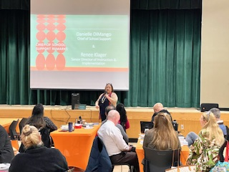
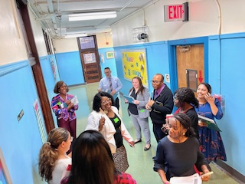
Literacy Proficiency
Math Proficiency
Chronic Absenteeism & Retention
Parent Engagement
Community
Superintendent
Dr. Eric L. Blake
Deputy Superintendent
Dr. Shonelle Hall
November 7, 2024
“With effort and support all schools can meet the needs of their students and help them achieve outstanding educational outcomes”

Slide 2
District 28 Vision, Mission & Goals
The United Nations' mission statement includes the line, "In this noble undertaking, cooperation, collaboration, unity, and solidarity must be the light we should seek and follow. We commit to strive for inestimable contribution to human progress."
Mission
In Community School District 28 we focus on equity as a lever for achievement for every single scholar. We are a district of excellence. We commit to every school maintaining high academic standards and working closely with families so that all scholars are learning at high levels. Beginning with school leaders, teachers, students and community partners, we also commit to being a district of learners ensuring that we promote critical thinking rooted in core content conceptual understanding through creative problem solving, technology innovation, social emotional learning and community advocacy.
Vision
In Community School District 28 we celebrate our differences because we understand that woven into those differences is the knowledge that they offer us unlimited possibility to learn and expand our knowledge of and commitment to all humanity. We are beautifully diverse, varied; coming from countless racial, ethnic, language, and belief backgrounds. We commit to striving for inestimable contribution to the lives of our scholars.

Slide 3
NYCPS Leadership:
The GREAT D28 Welcomes Chancellor Melissa Aviles – Ramos!
She was formerly the Deputy Chancellor of Family and Community Engagement and External Affairs, as well as the Chief of Staff to former Chancellor David C. Banks. In those roles, she oversaw innovative family engagement programs such as NYC Literacy Hubs and launched and led Project Open Arms, our unprecedented effort to welcome, enroll, and support 45,000-plus of our newest New Yorkers. We look forward to you visiting and seeing the great D-28!

Slide 4
D28 Superintendent Priorities:
• Improve outcomes in Mathematics by implementing a common research-based curriculum and introducing or scaling, where appropriate, Regents level courses for scholars.
• Improve literacy skills by implementing research-based, Science of Reading (SOR) HMH curriculum in all K-8 schools.
• Work to substantially improve daily attendance and reduce chronic Absenteeism.
• Continue to increase Parent and Family Engagement and Community Partnerships.

Slide 5
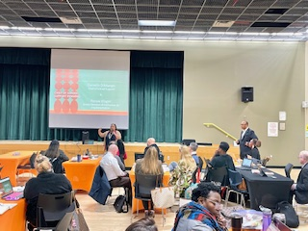
Chief of School Support Dimango’s visit to D-28
Chief Dimango visited D28 Principals Conference @ MS 358Q / PS 349Q
NYC READS
NYC SOLVES

Slide 6
ELL Summary Report
Almost 25% of our student population are ELLs current or former.
Of that percentage, more than half sit in our K-5 classrooms, with
the largest numbers in grades K and 3
English Language Proficiency (ELP's) levels varies across grade
bands, with a growing population of entering/emerging language
learners and high concentrations of expanding language learners.
We must create, sustain and expand opportunities for inclusivity
across our classrooms that welcome and affirm all learners.

Slide 7
Autism Workshop for District Staff to Support Schools
The DOE has developed capacity-building training for district staff on best practices to support autistic students in community schools. My office has identified two staff members to become experts in supporting autistic learners. The following supports are available for these identified staff members:
Overview of Autism
Overview of Communication Skills
Overview of Executive Function Skills
Sensory Processing and Regulation

Slide 8
D28 Attendance Snapshot
DCEP - Attendance Goals
By June 2025, we will increase district-wide attendance by 2 percentage points from 90.7% to 92.7% excluding students who are long-term international travelers.
By June 2025, we will reduce overall chronic absenteeism by 10% of overall Chronically Absent Students EOY 23/24 from 35% to 31%, excluding students who are long-term international travelers.
Where are we Now: 10/31/24
YTD Overall Attendance: 92.7% vs 90.9% Citywide
Chronic Absenteeism YTD: 24.6% vs 26.4% SAME DATE LAST YEAR
Professional Development: Election Day
D28 collaborated with Districts 26, 30, Bronx HS & Consortium of Internationals, Outward Bound Schools (citywide)
Focus on school-based practices to improve both overall attendance and chronic absenteeism
D28 DAC Goodman and D30 DAC Birardi meet weekly to collaborate
Principals Lever Group Session 1– Attendance
Group of 5 Principals met to begin collaborating on a root cause and best practices discussion

Slide 9
D28 Class Size/Initiatives:
Class Size Reduction:
Presently, we are achieving our 3% target for class size Reduction
New York City target for 2025-2026 is 60% reduction in class size.
For the 2025-2026, class size reduction will be encompassing a joint (NYCPS, UFT, CAA) school-based approach whereby school leaders and their SLT will submit their application for funding (via a new SAM) to continue class-size reduction for the 2025-2026 school year. The applications will be due on December 20th, 2025. Funding will be contingent of the review of the application.

Slide 10
Congratulations to our very own Vijah Ramjattan
Vijah was recognized and honored by the Mayor and City Council for his exceptional leadership on the CEC, as well as his advocacy, mentorship, and support for those within our community. Vijah, your dedication and vision have significantly contributed to the success and progress of our school community. We are grateful for your steadfast support in our continued efforts to improve our schools, and the support you provide to our students , parents, and educators. Congratulations on this well-deserved honor!

